Slide 1

Use Cases of Data Mining
Applications of data mining & data analytics
Blackwell electronics

Slide 2
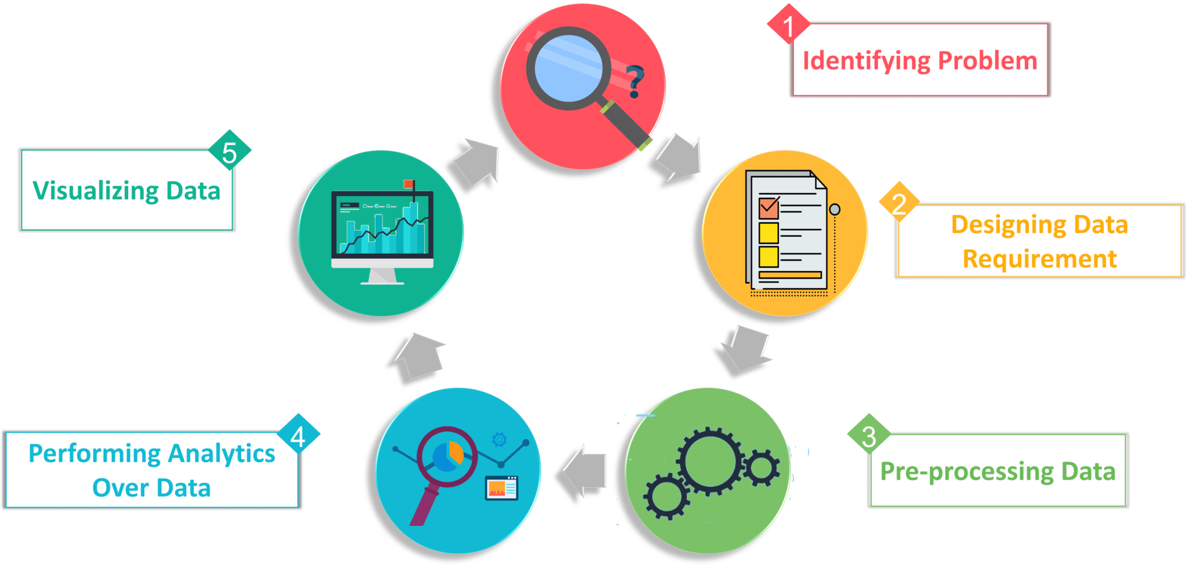
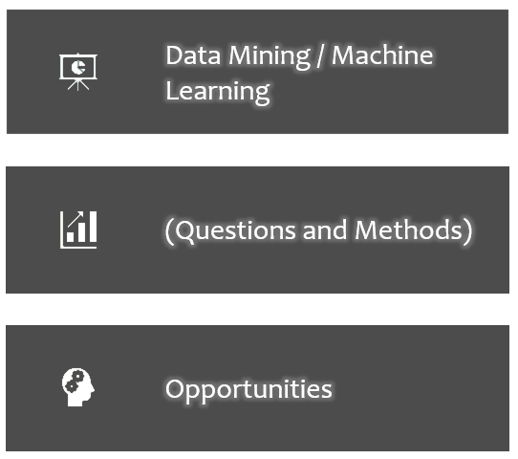
Data Analytics Process
Data analytics is the science of analyzing raw data in order to make conclusions about that information.
Many of the techniques and processes of data analytics have been automated into mechanical processes and algorithms that work over raw data for human consumption
Data mining is the process of discovering patterns in large data sets involving methods at the intersection of machine learning, statistics, and database systems

Slide 3

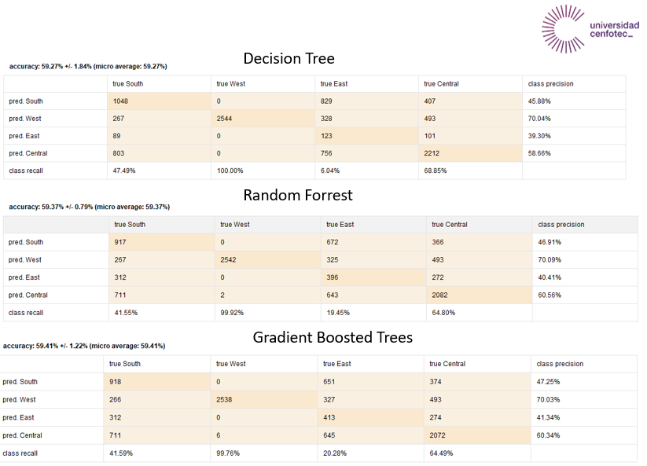
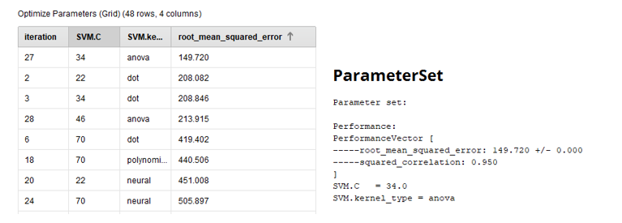
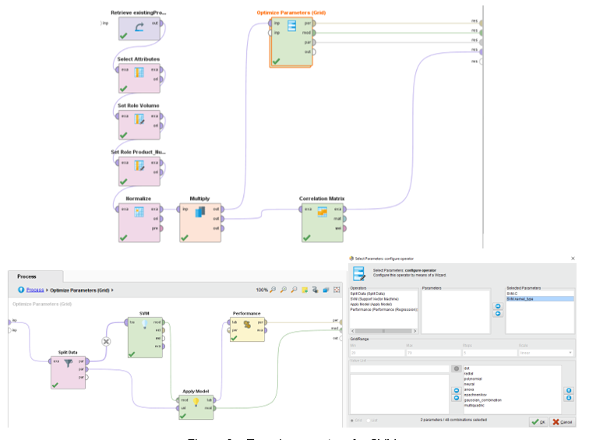
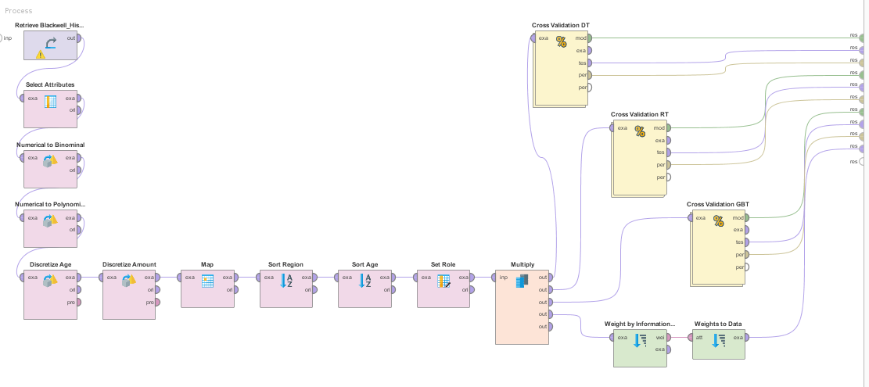
Data Mining / Machine Learning

Slide 4

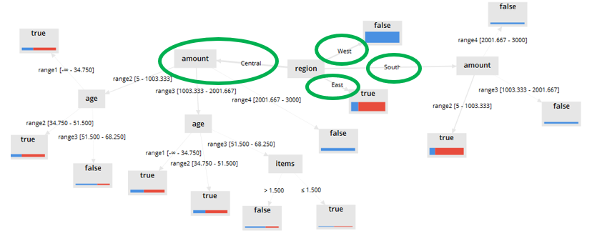
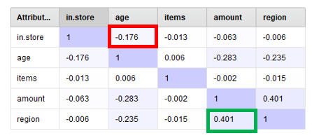
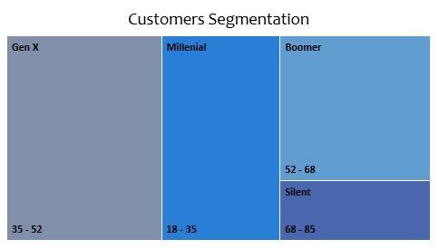
Use Case # 1 – Investigate customer buying patterns
Questions and Methods
1 – Difference between regions spend per transaction?
2 – Differences in the age of customers between regions?
3 – Confirm or discard hypothesis, identify level of correlation between variables.
4 – Determine factors to predict specific behaviors

Slide 5
Use Case # 2 – Predicting Profitability
Questions and Methods
1 – Difference between regions spend per transaction?
2 – Differences in the age of customers between regions?
3 – Confirm or discard hypothesis, identify level of correlation between variables.
4 – Determine factors to predict specific behaviors

Slide 6

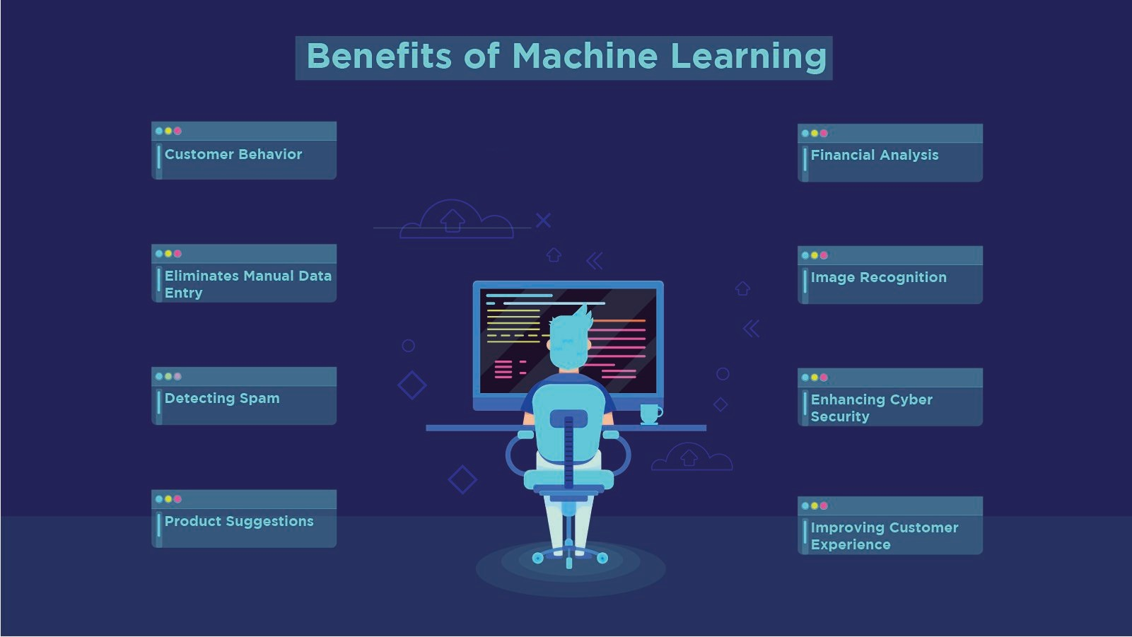
Opportunities

